Slide 1
Capstone Expo:
An Optimal Drone End-Effector for Vegetation Pruning
Team Name: Drones for Tree Trimming
April 27th, 2021
Tyler Bryant, Darrell Fambro, Keith Liang, Nikhil Patel, Matthew Ramberger

Slide 2
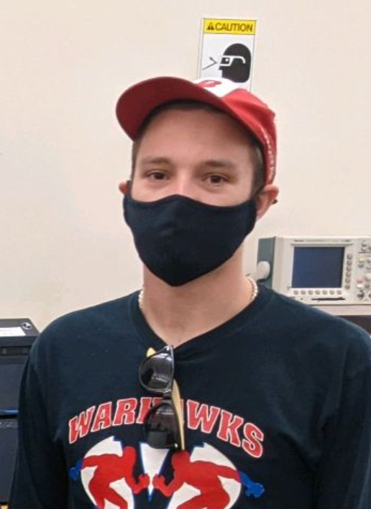
Meet the Team
Matthew Ramberger [EE]
Darrell Fambro [CmpE]
Nikhil Patel [CmpE]
Tyler Bryant [EE]
Keith Liang [EE]
Testing Team Lead
Webmaster
Software Team Lead
Hardware Team Lead
Director of Communications

Slide 3
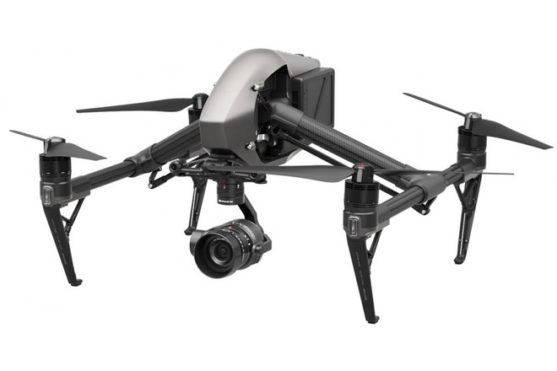
Introduction
Goal: Design an optimal end effector configuration that integrates with a DJI Inspire Drone
Optimal: Perform light trimming and pruning of vegetation surrounding power lines
Able to withstand repetitive impact with grass and dirt from a height range of 30-50 feet
The end effector will attach to a branch and disconnect from the drone, allowing the drone to safely fly away while the cut is made
DJI Inspire 1

Slide 4
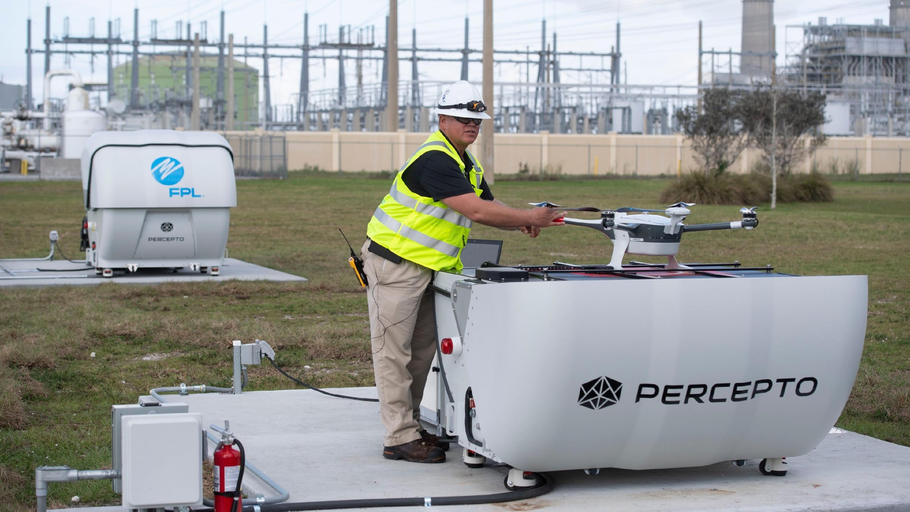
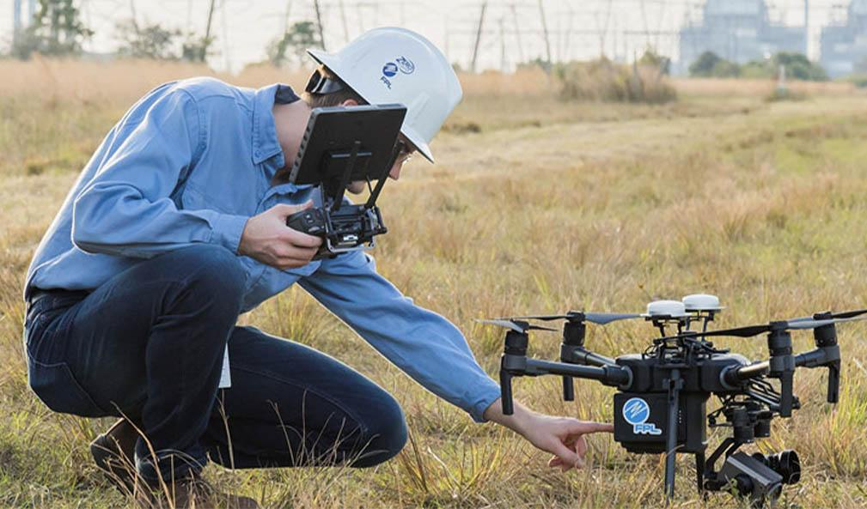
Motivation
Implement the use of drones to provide safer and more reliable services to customers
Florida Power & Light Aerial Intelligent Response (FPLAIR)
Oversees all aerial inspections of the company’s overhead transmission and distribution facilities
Percepto “Drone-in-Box” Solutions to aid in hurricane disaster recovery

Slide 5
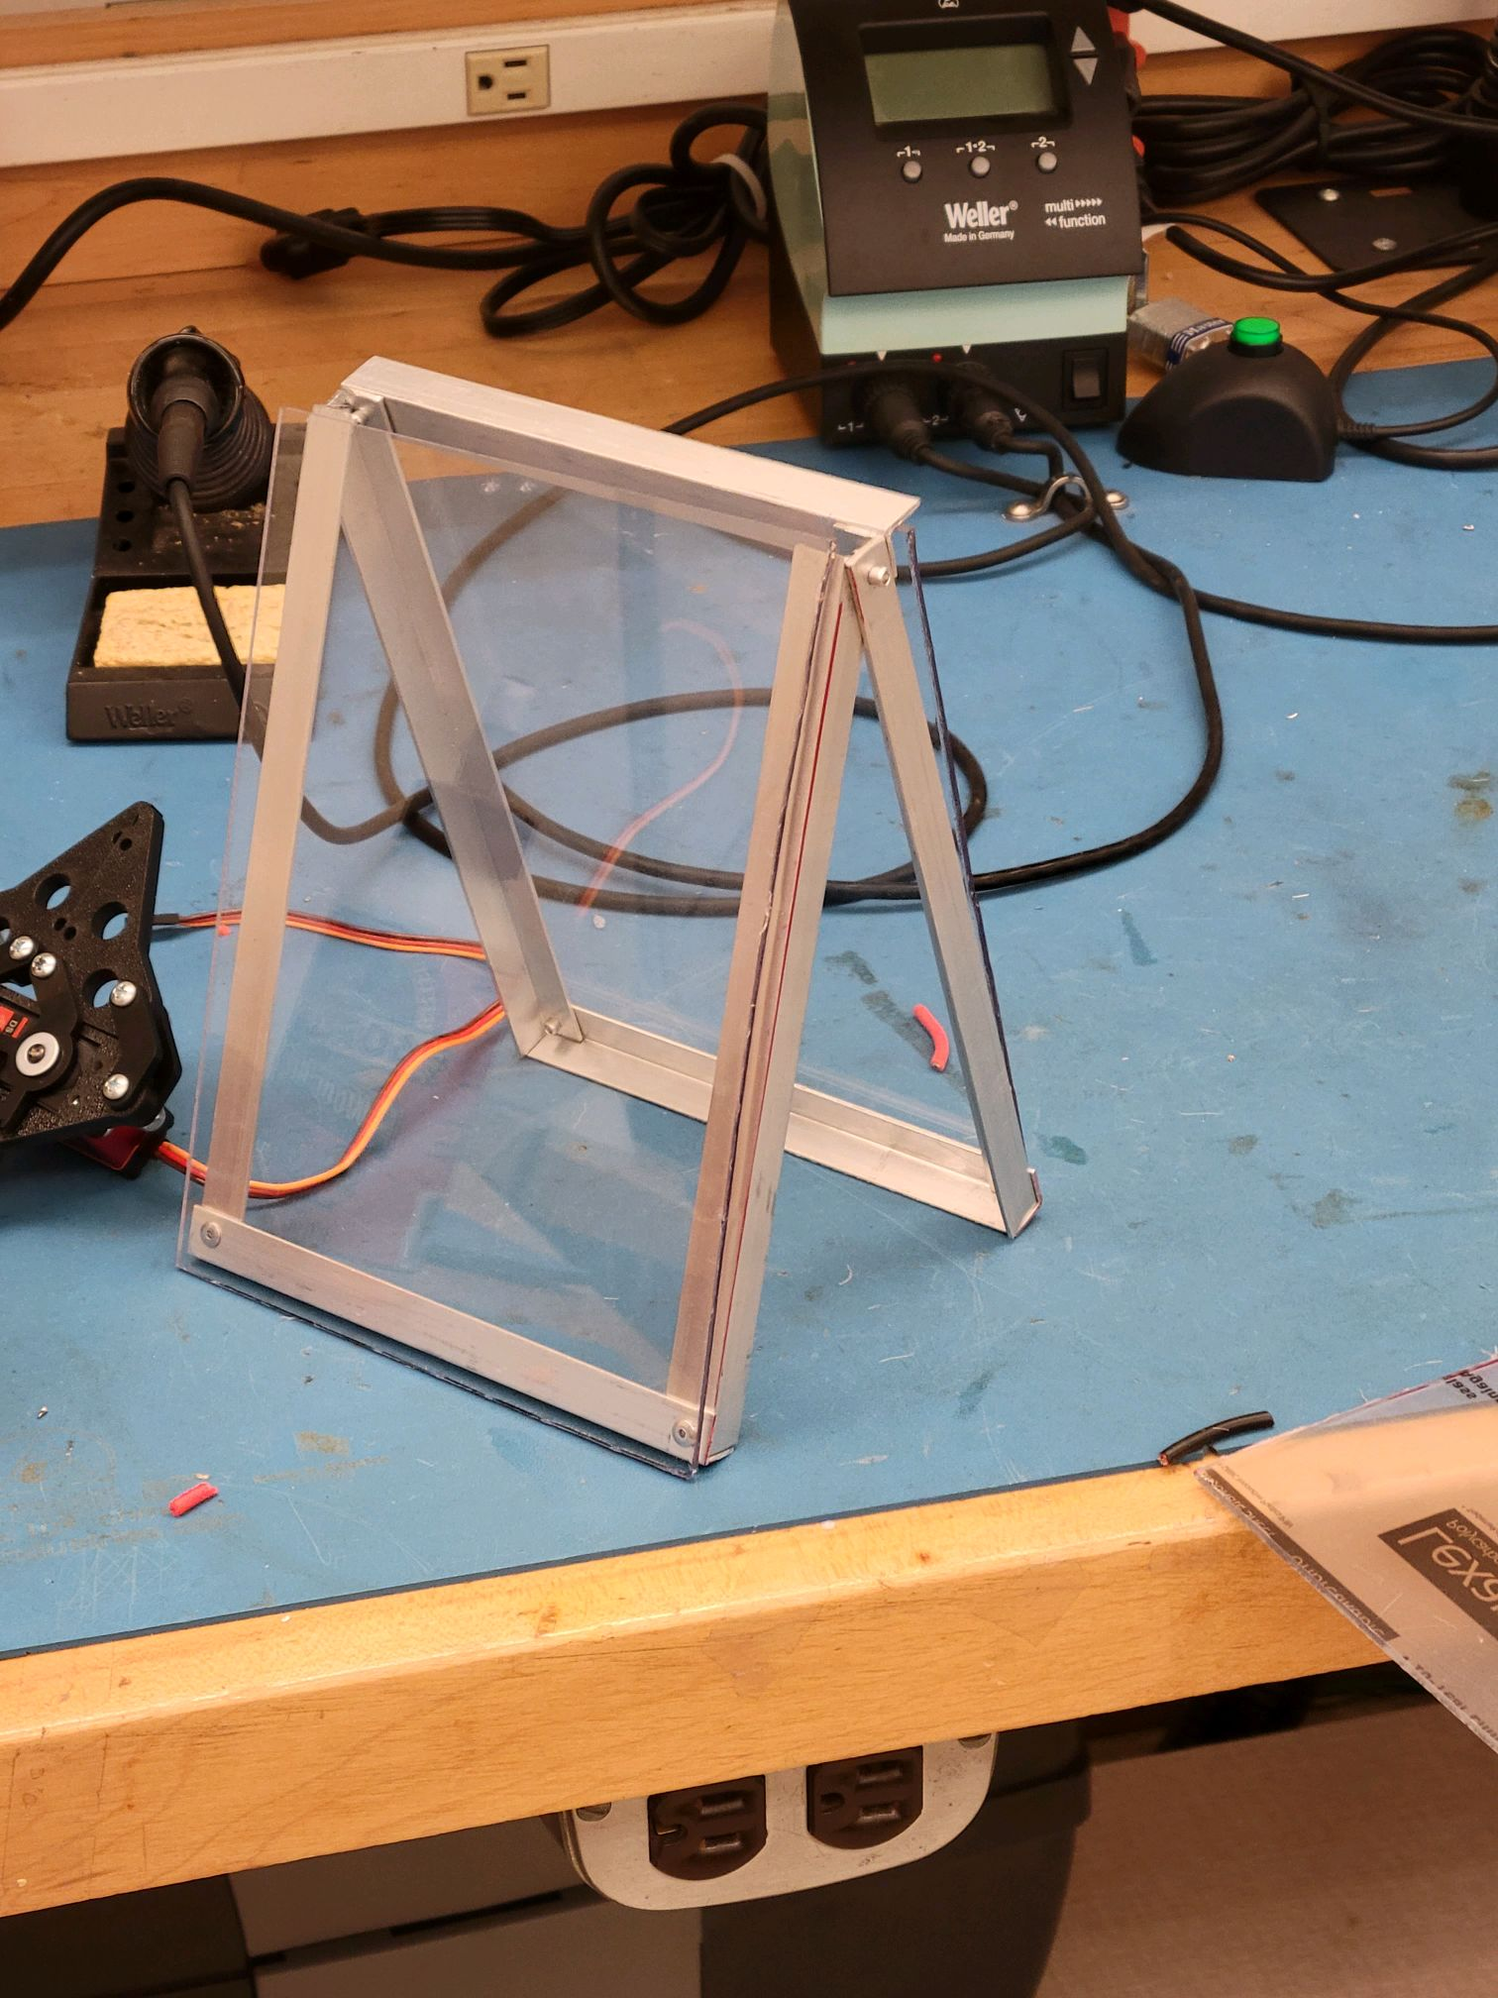
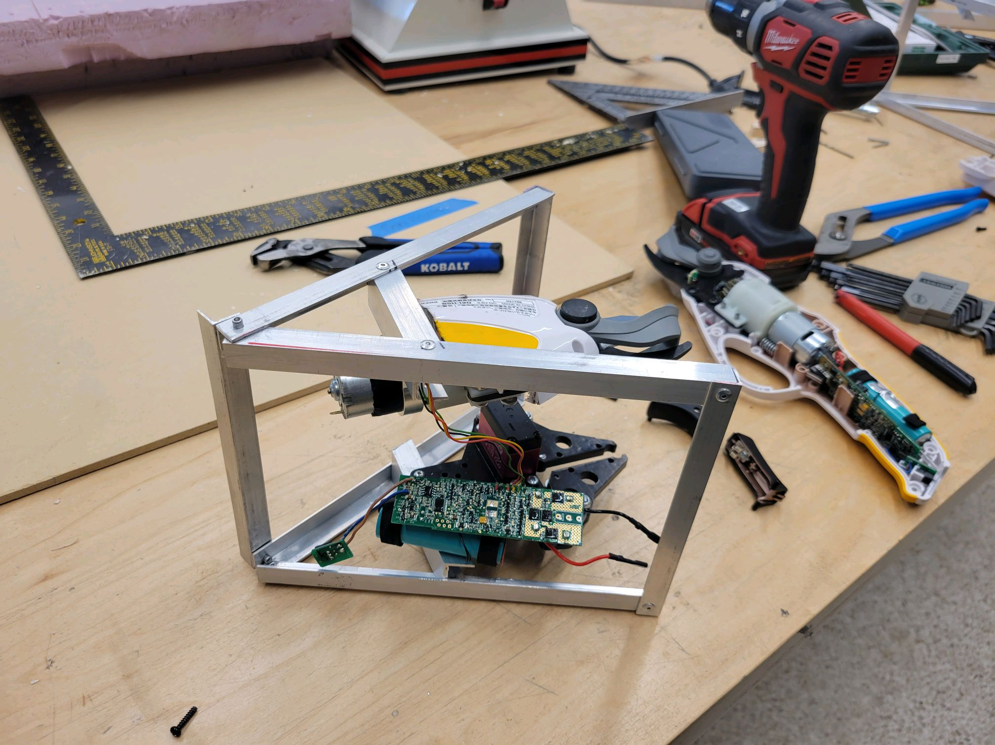
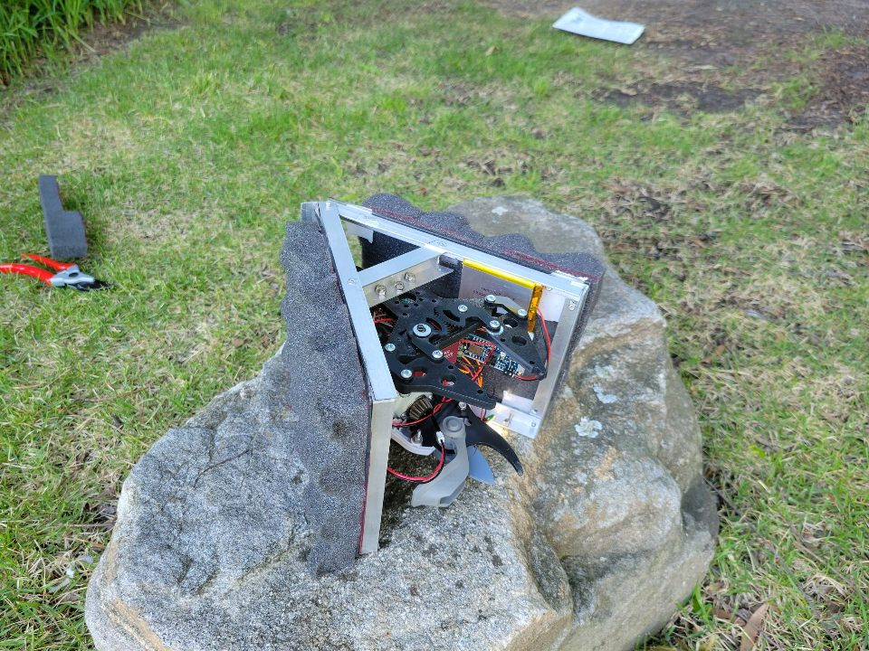
End-Effector Mechanical Assembly
Hardware Components
L-Shaped aluminum core structure
Ryobi BSH-120 Gardening Tool
ACTOBOTICS Parallel Gripper Kit
Flying Tech Payload Release Mechanism
Lexan Polycarbonate Sheets
Foam Cushioning
Aluminum Frame with Lexan
Aluminum Frame w/ support bars, cutter, and clamp
Finished End-Effector

Slide 6
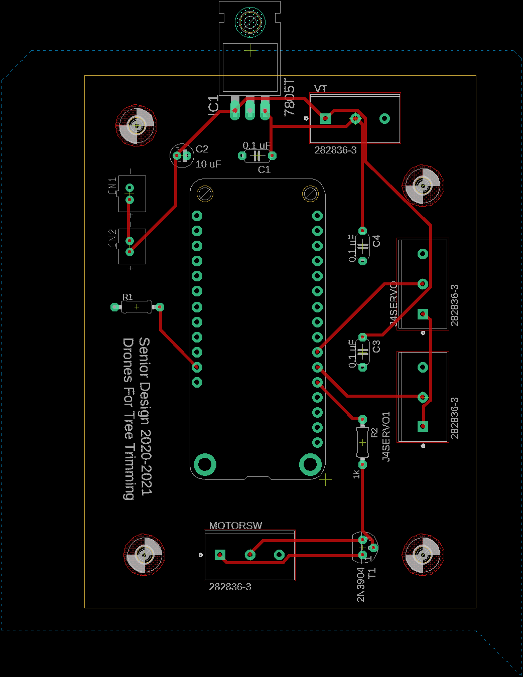
End-Effector Electrical Systems
Accelerometer
Voltage Regulator (5V)
Two NPN BJT Transistors
Battery Terminals
Microprocessor
PCB Design
Soldered Breadboard

Slide 7
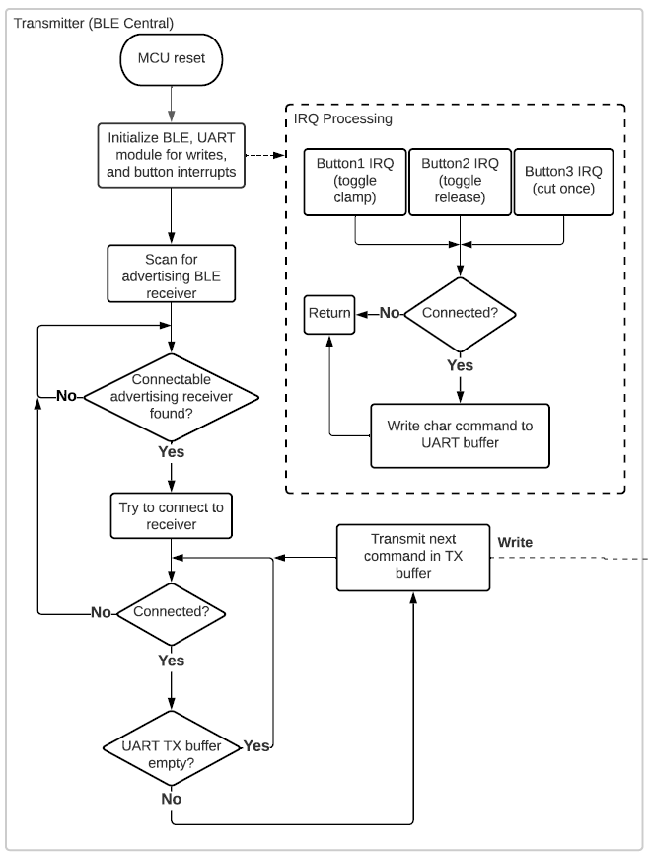
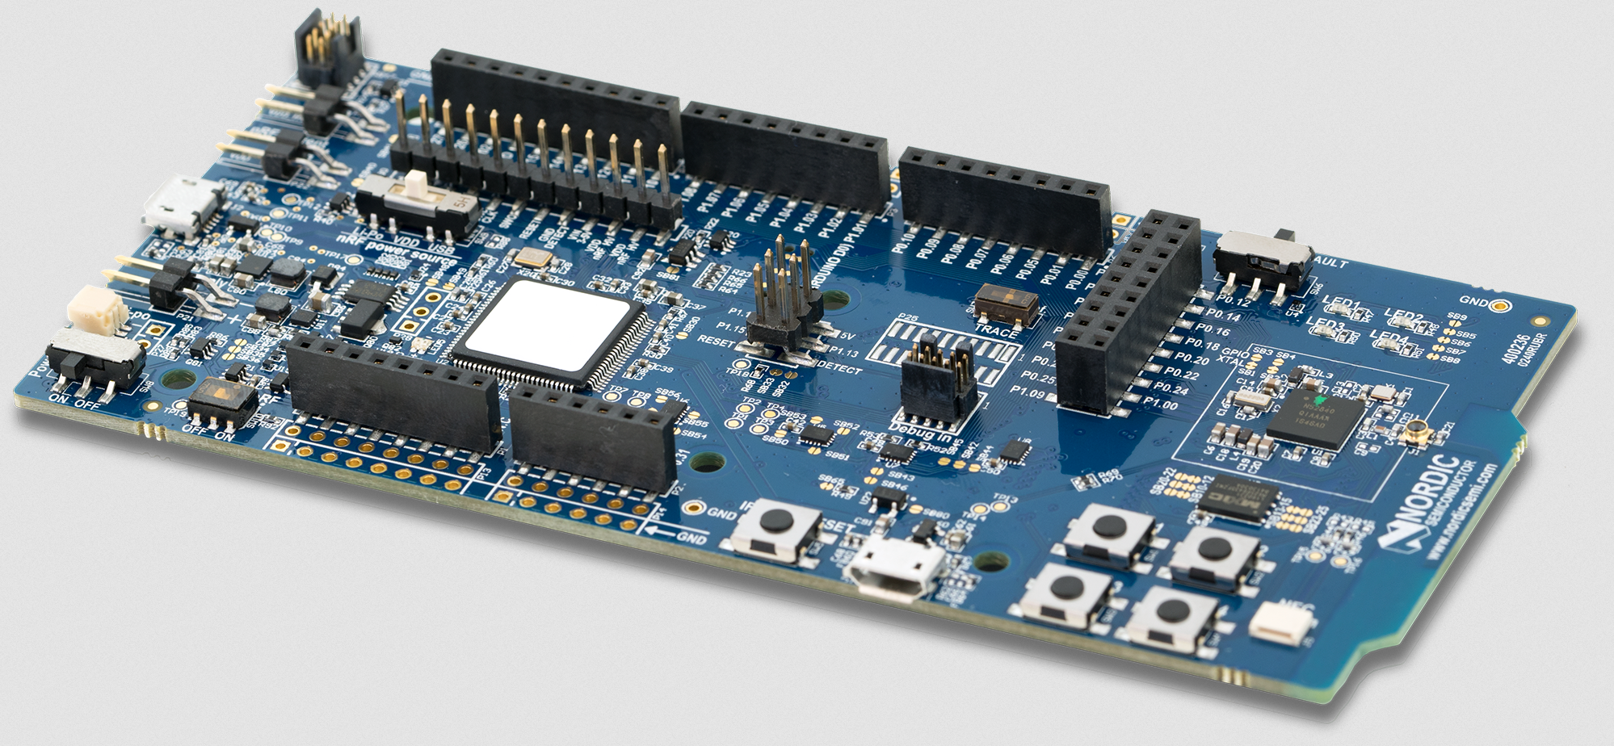
End-Effector Software Design
Communications between controller and end-effector are done using UART over bluetooth
2 nRF52840 microcontroller development boards
The nRF52840 chip has a built-in bluetooth module capable of long ranges (> 200 ft)
The nRF52840-DK board transmits character based commands to the end-effector’s board (i.e. ‘!C’, ‘!T’, ‘!R’)
Pressing a button triggers transmission (see right)
Transmitting controller software flow diagram
nRF52840-DK development board

Slide 8
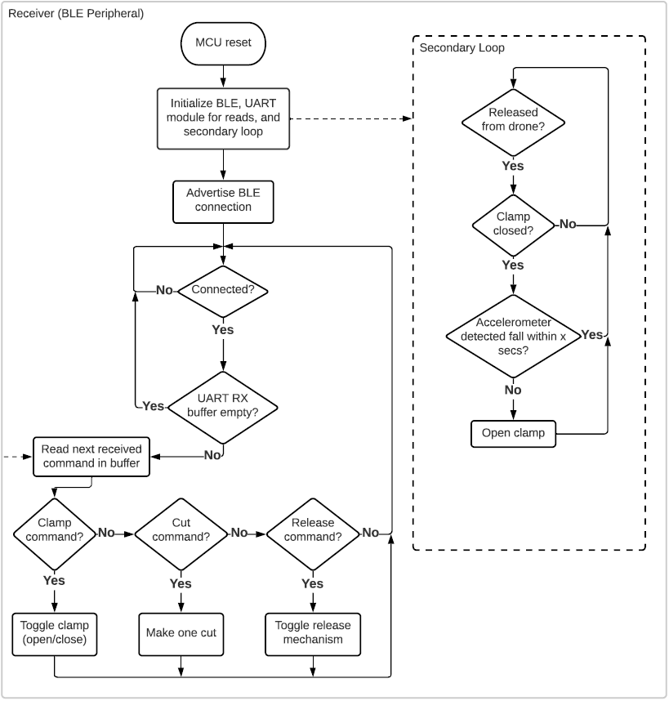
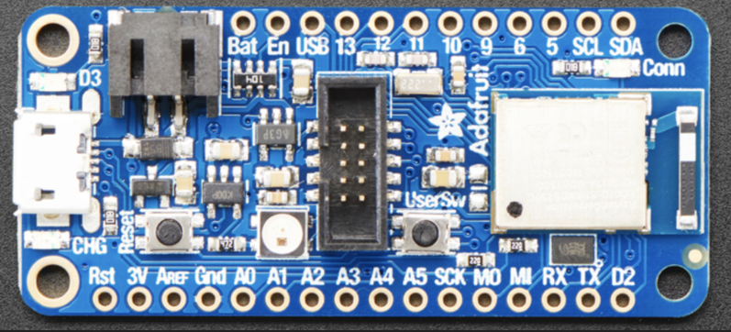
End-Effector Software Design
The nRF52840 Feather Express receives commands and parses them
Toggles the clamp, cutter, and release accordingly by sending out the appropriate signal on a pin (see right)
Detects if the end-effector is stuck after being released from the drone using an accelerometer (i.e. in a tree)
Releases clamp if no fall detected 30 sec after drone release
Receiving controller software flow diagram
nRF52840 Feather Express development board

Slide 9
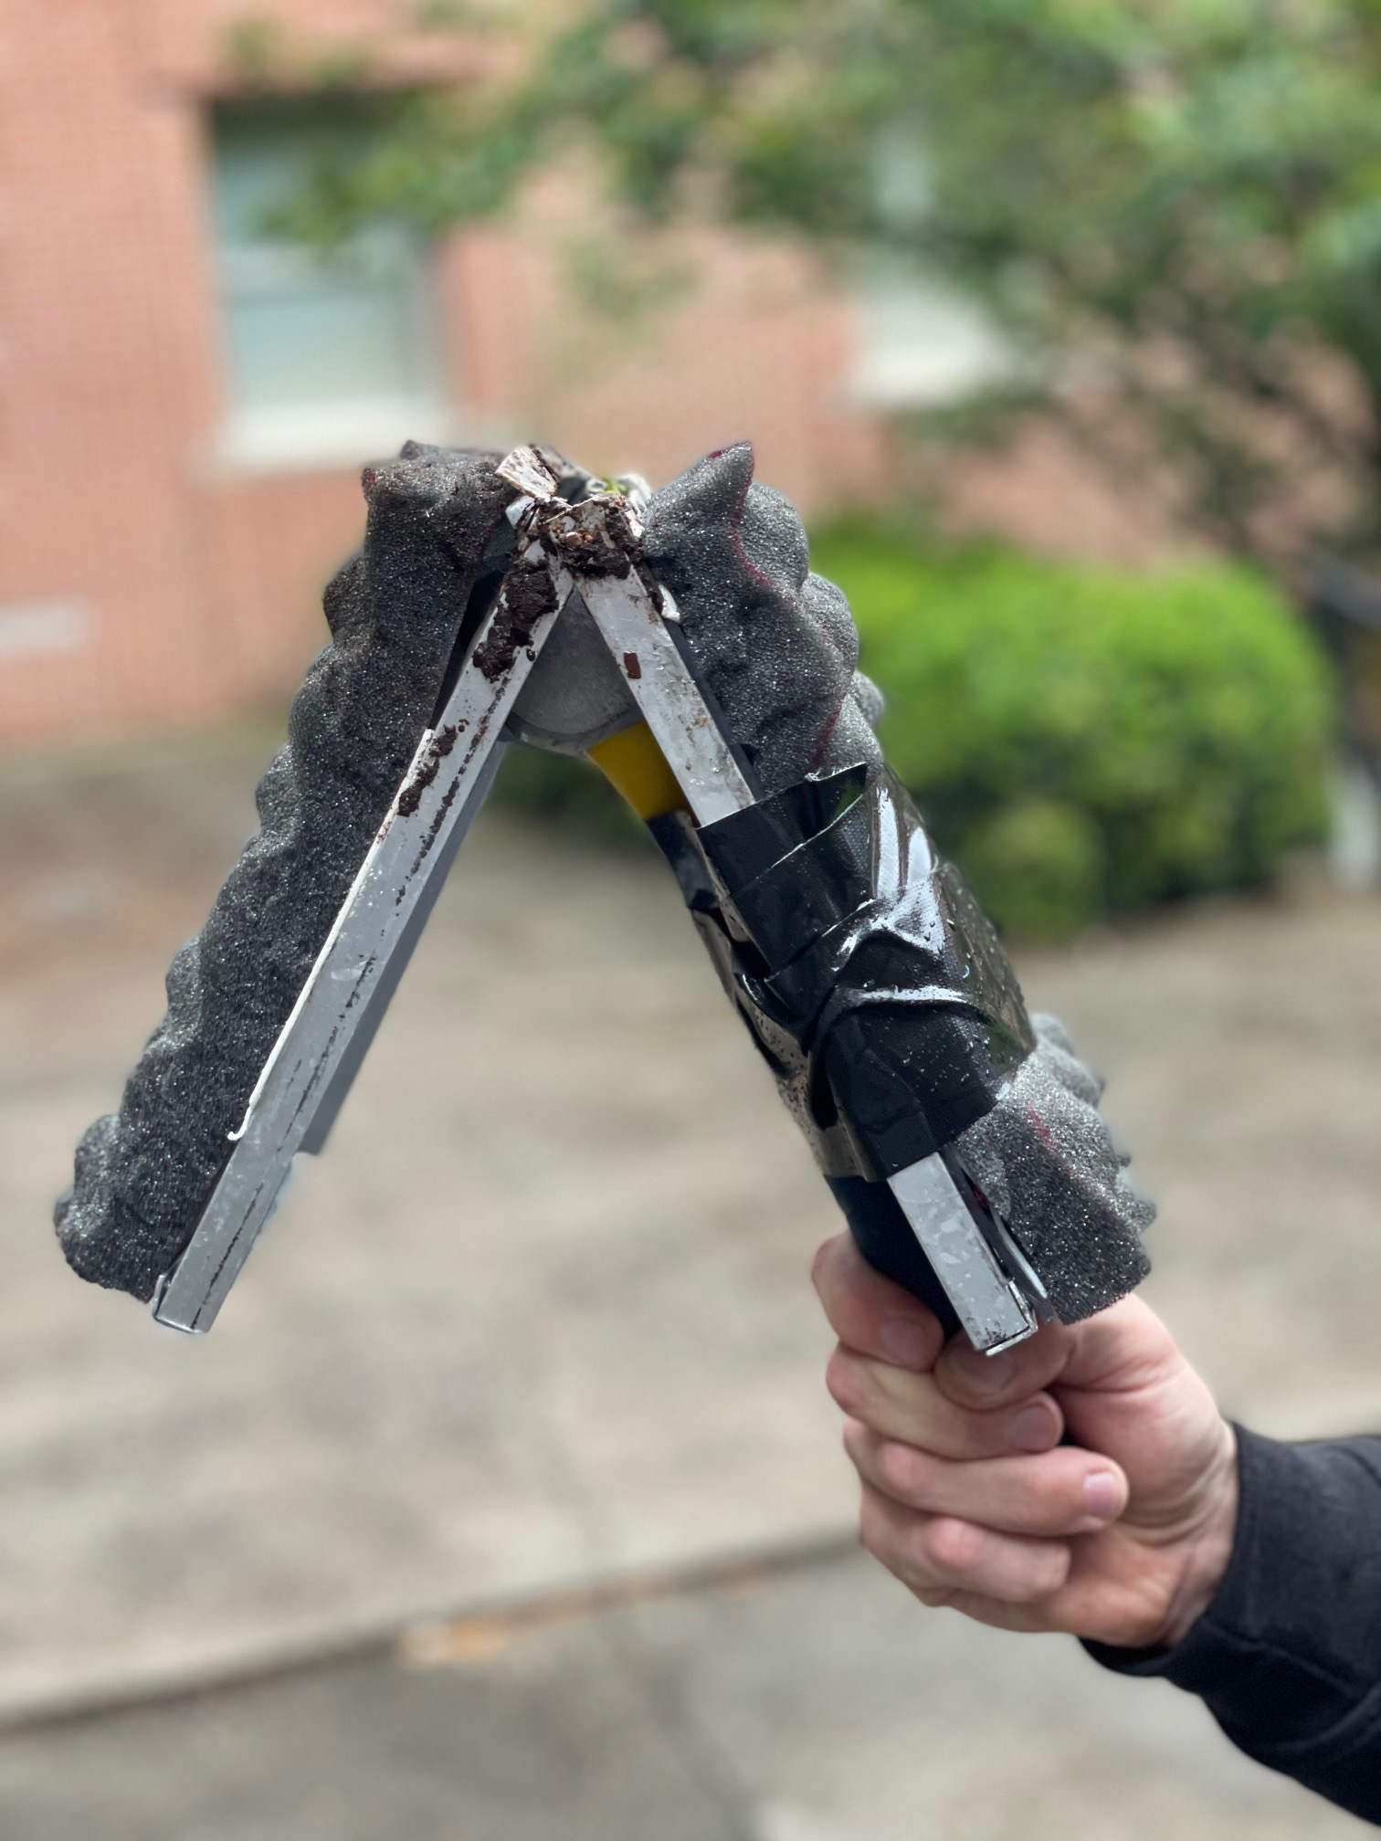
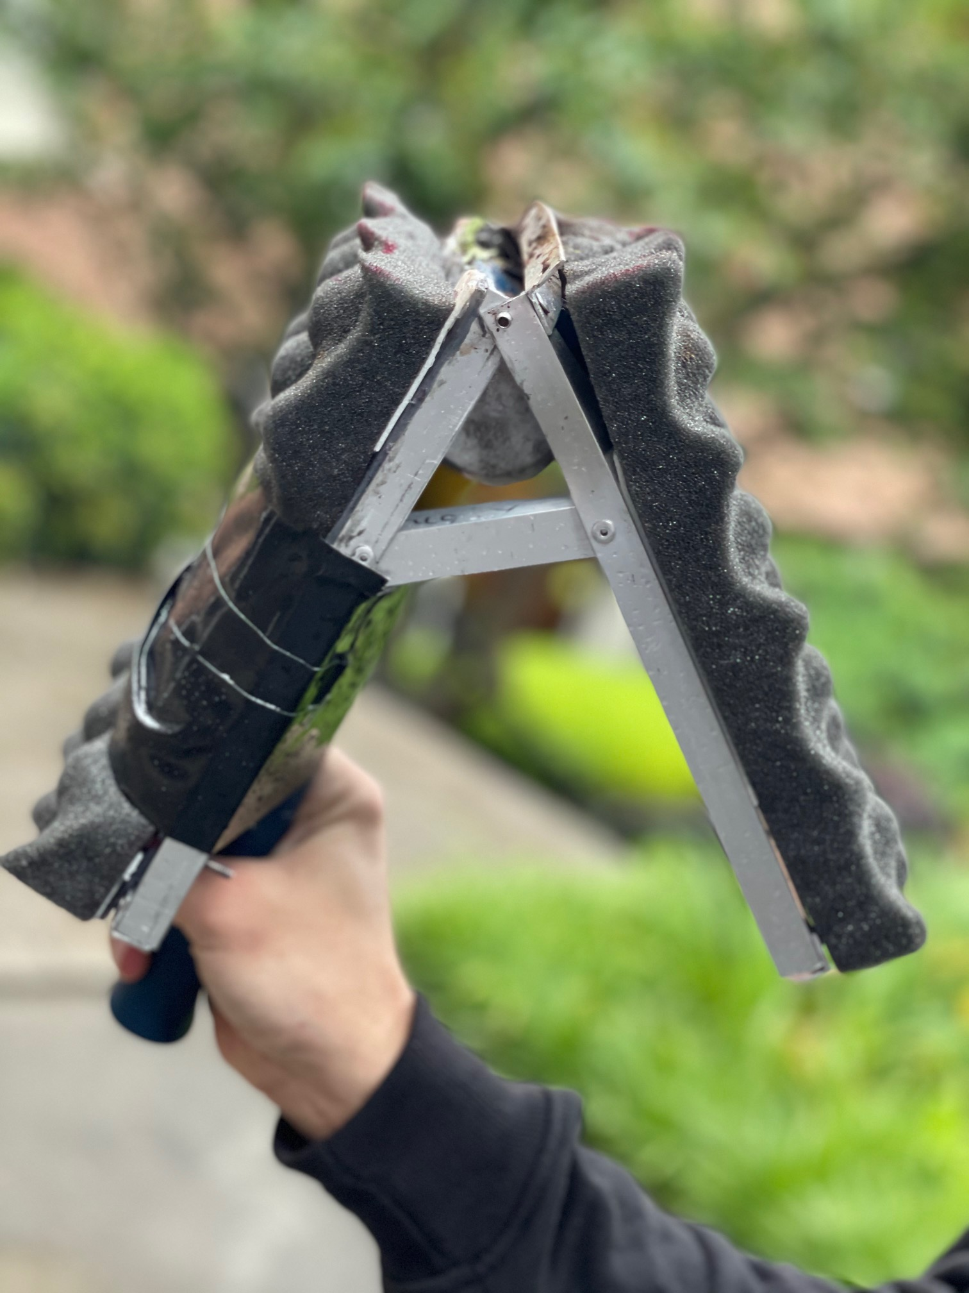
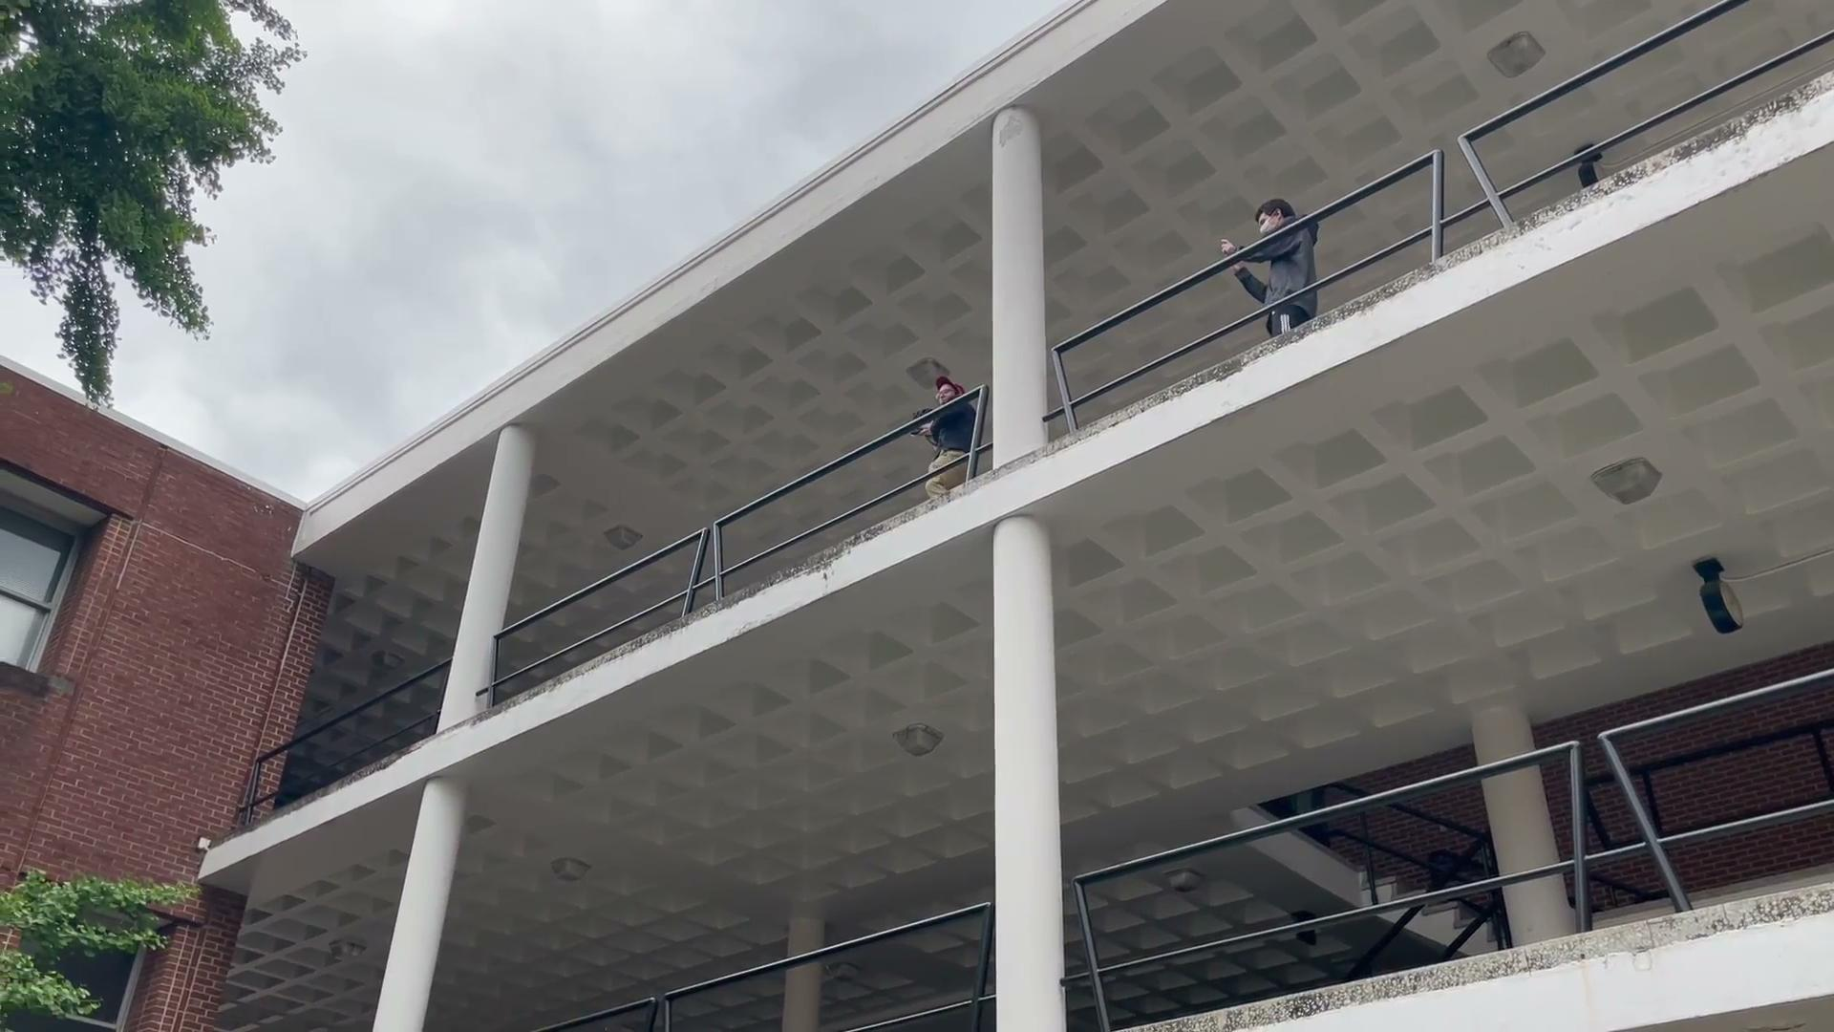
Drop Test Video
Drop Test #1: ~20 feet
Results
Drop test was around 4 lbs - 1.5x our current weight
Framing easily survived both drops
Dirt getting inside frame is a problem
Drop Test #2: ~40 feet

Slide 10
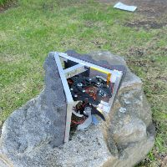
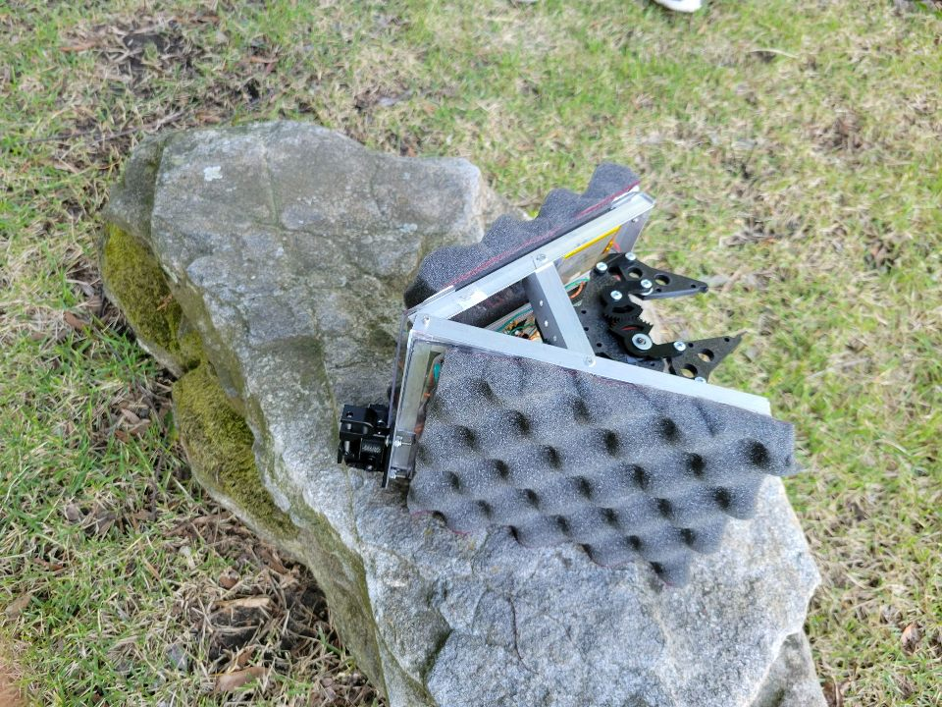
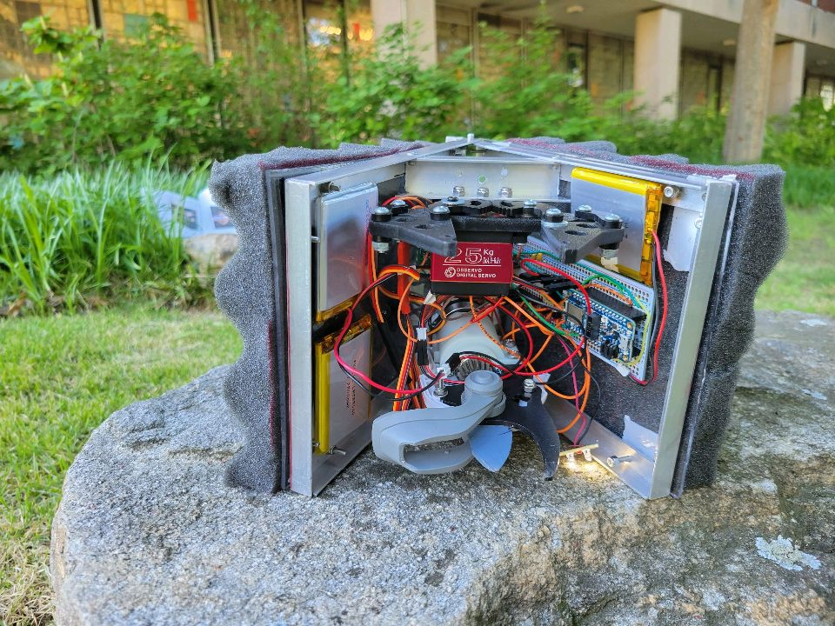
Testing and Results
Weight ~ 2.5 pounds
Signal Range ~ 200-250 feet LOS
Battery Lifetime ~ 45-60 minutes
Fall Survival Height ~ Survived 40 Feet
Cutting Size ~.10’’ - .40’’
Inconsistent over .40’’

Slide 11
Future Steps
Additional release mechanism for vertical cuts
Integrating release mechanisms inside frame
Upgrading soldered breadboard to printed circuit board
Increased diameter and power of cut potential
Adding shock absorbent mounting
Upgrading to titanium framing
Upgrading drone to increase payload capacity

