Slide 1
Drones for Tree Trimming
ECE 4872 Senior Design Project
Sponsored by: Florida Power & Light
Advisor: Dr. James Kenney
Matthew Ramberger
Nikhil Patel
Darrell Fambro
Keith Liang
Tyler Bryant

Slide 2
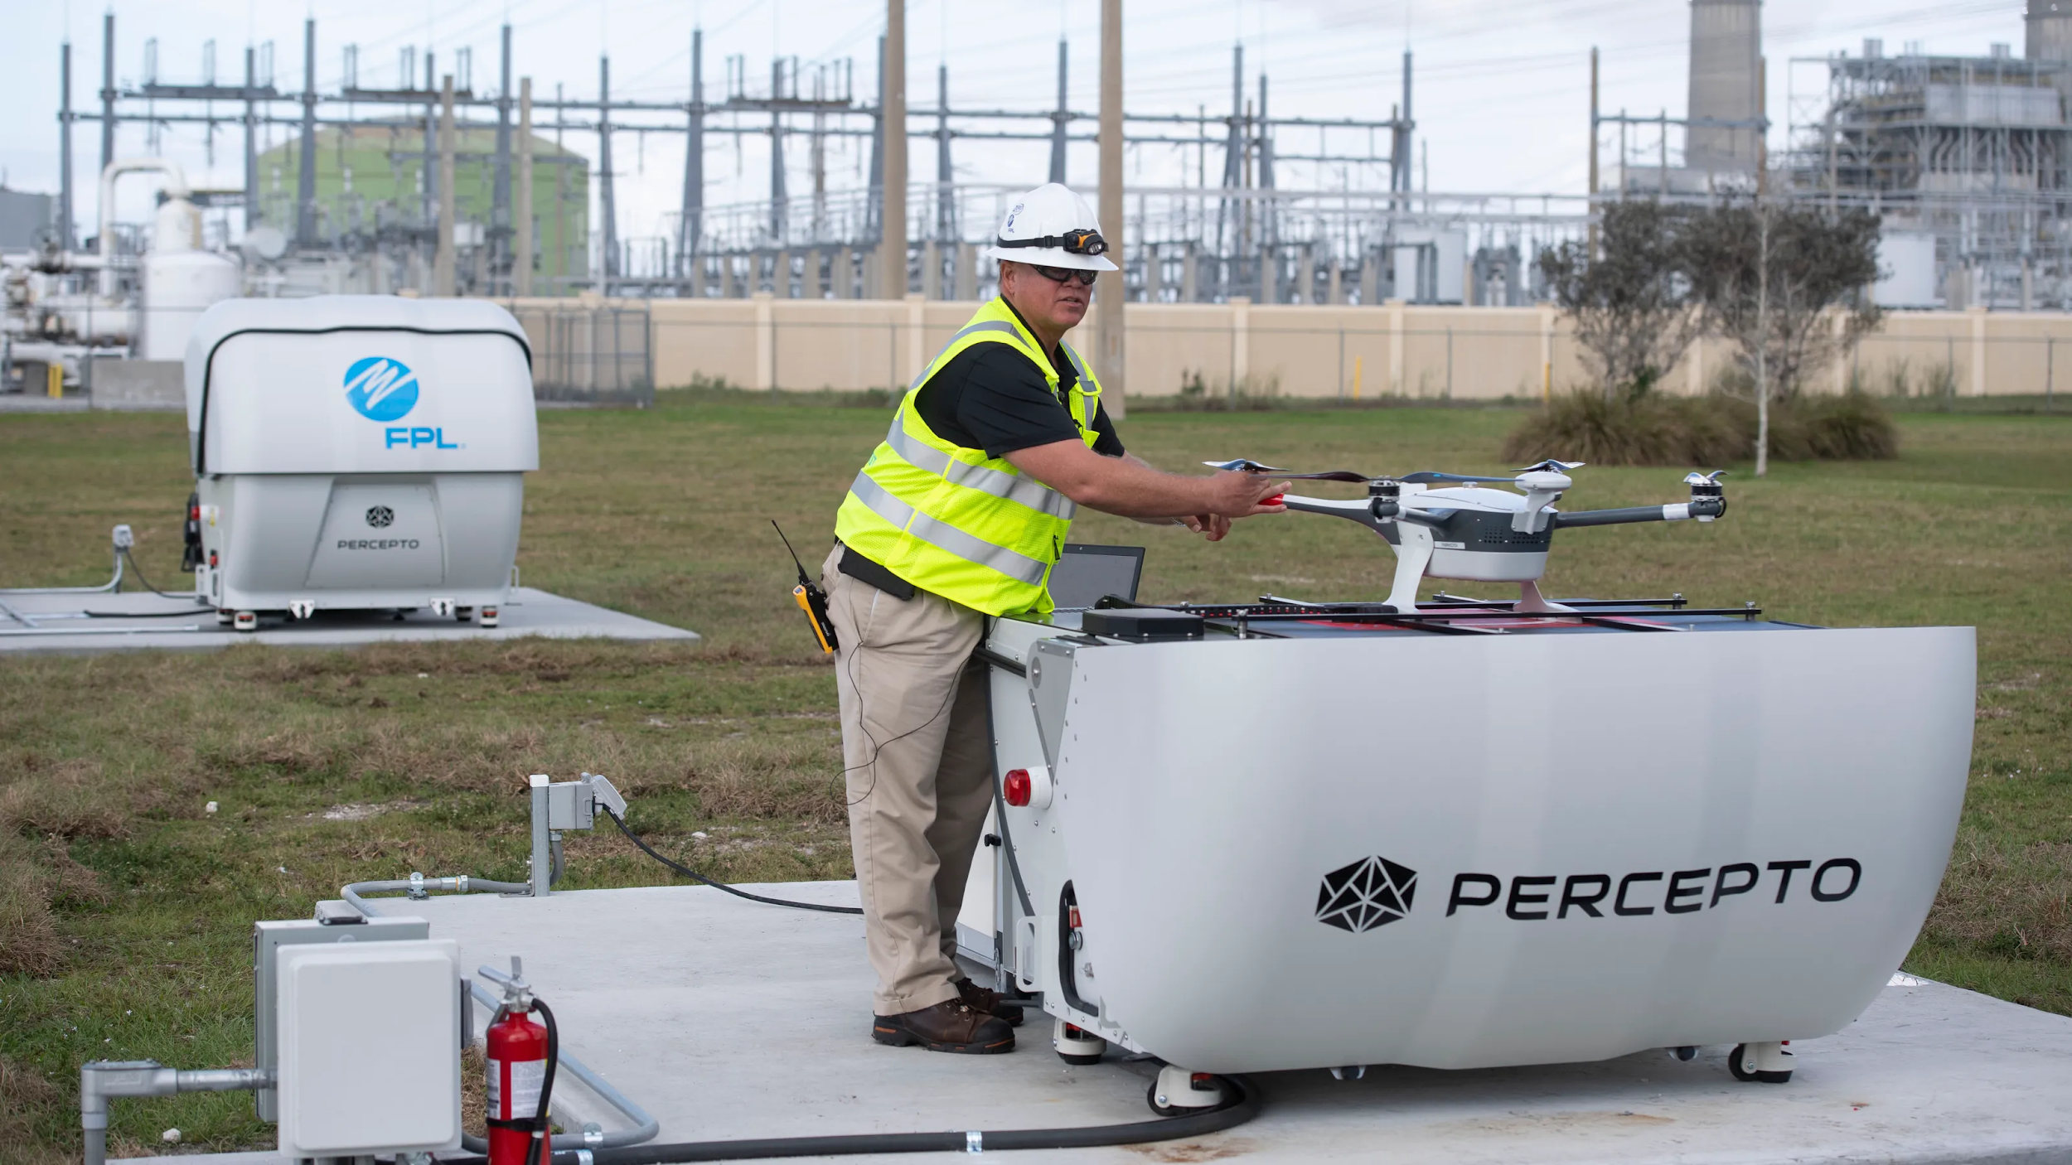
Background
Florida Power & Light Aerial Intelligent Response (FPLAIR) department oversees all aerial inspections of the company’s overhead transmission and distribution facilities.
The specific use of drone technology in these aerial inspections gave birth to the idea of drone usage in vegetation pruning for customers
As a result of Hurricane Dorian , FPL deployed new “drone in box” technology that can quickly focus on hard-to-reach spots up to 2 miles away, assessing damage in surrounding areas

Slide 3
Motivation
Florida Power & Light is currently the largest energy company in the United States, providing service to more than 10 million people across the state of Florida.
The motivation stems from FPL having the vision to implement the use of drones in order to provide faster and safer services to their customers in the area of removing vegetation in close proximity to service wire poles.
Our team is determined to develop a prototype that will deploy to a customers home and clear the impending vegetation

Slide 4
Objective
The team will design and prototype an optimal end effector configuration that can integrate with a DJI Inspire Drone in order to perform light trimming and pruning of vegetation surrounding power lines.
The end effector will be impact resistant and will be able to withstand repetitive impact with grass and dirt from a height range of 30 -50 feet.
In the event the end effector becomes entangled on a piece of vegetation, the end effector will disconnect from the drone, allowing the drone to safely fly away and return to the tethered area

Slide 5
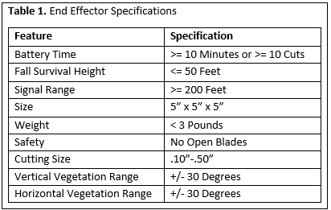
End Effector Technical Specifications
Battery Lifetime
>= 10 Minutes or >= 10 Cuts
Fall Survival Height
<= 50 Feet
Signal Range
>= 200 Feet
Size
5” x 5” x 5”
Weight
< 3 Pounds
Cutting Size
.10”-.50”
Cutting Range
+/- 30 Degrees Vertically
+/- 30 Degrees Horizontally

Slide 6
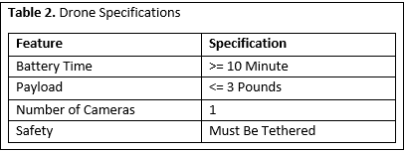
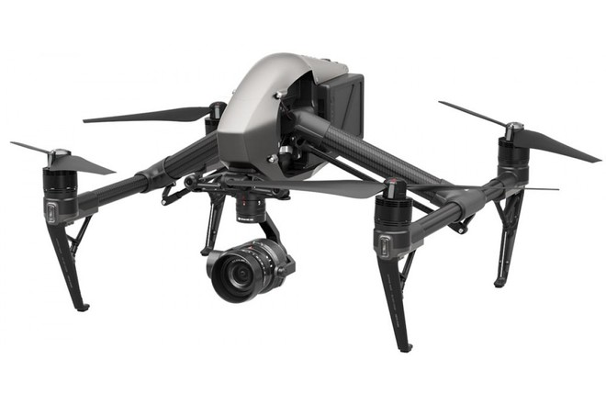
Drone Technical Specifications
Battery Time
>= 10 Minutes
Payload
<= 3 Pounds

Slide 7
Safety Guidelines
Prototypes must be approved by FPL before fabrication
No open saw blades, sharp edges, or rotating chains
Drone must be tethered when testing
Team must wear proper PPE during testing
Hard Hat, Safety Glasses, Closed Toed Shoes, Long Sleeve Shirt, Work Gloves

Slide 8
Covid Guidelines
Outside of Meetings
Wearing Masks/Social Distancing
Getting tested by GA Tech Weekly
Avoiding large gatherings/events
During Meetings
Properly sanitizing equipment
Wearing Masks
Meeting in large, open-space areas

Slide 9
Design Approach
The first step in the design approach is attaching the end effector to the limb.
To solve the issue of vertical and horizontal cuts, the implementation of a pin joint will attach the end effector to the drone.
This will allow the end effector to pivot between 0 and 90 degrees.
Example of pin joint allowing for unidirectional movement.

Slide 10
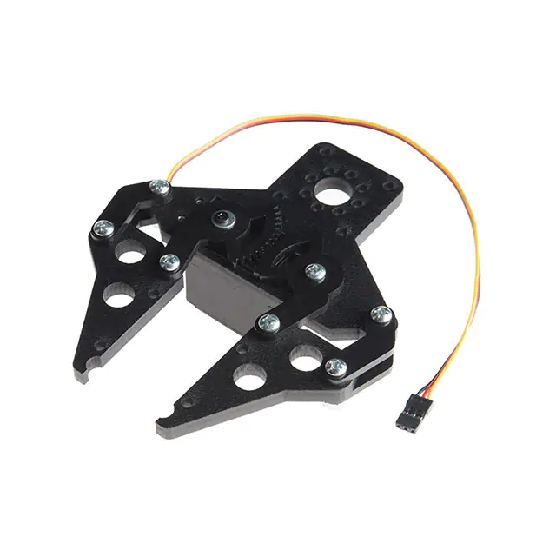
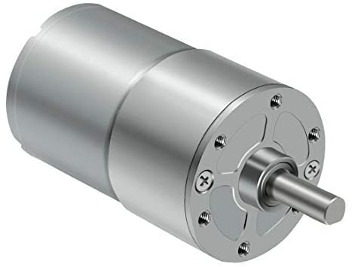
Design Approach
After positioning, the end effector must clamp onto the branch allowing for the drone to detach.
This will be accomplished by a clamp driven by a geared motor.
The geared motor will actuate the clamp onto the branch positioning the end effector in place allowing the drone to leave.
Sample clamp and geared motor from Sparkfun and Amazon, respectibly.

Slide 11
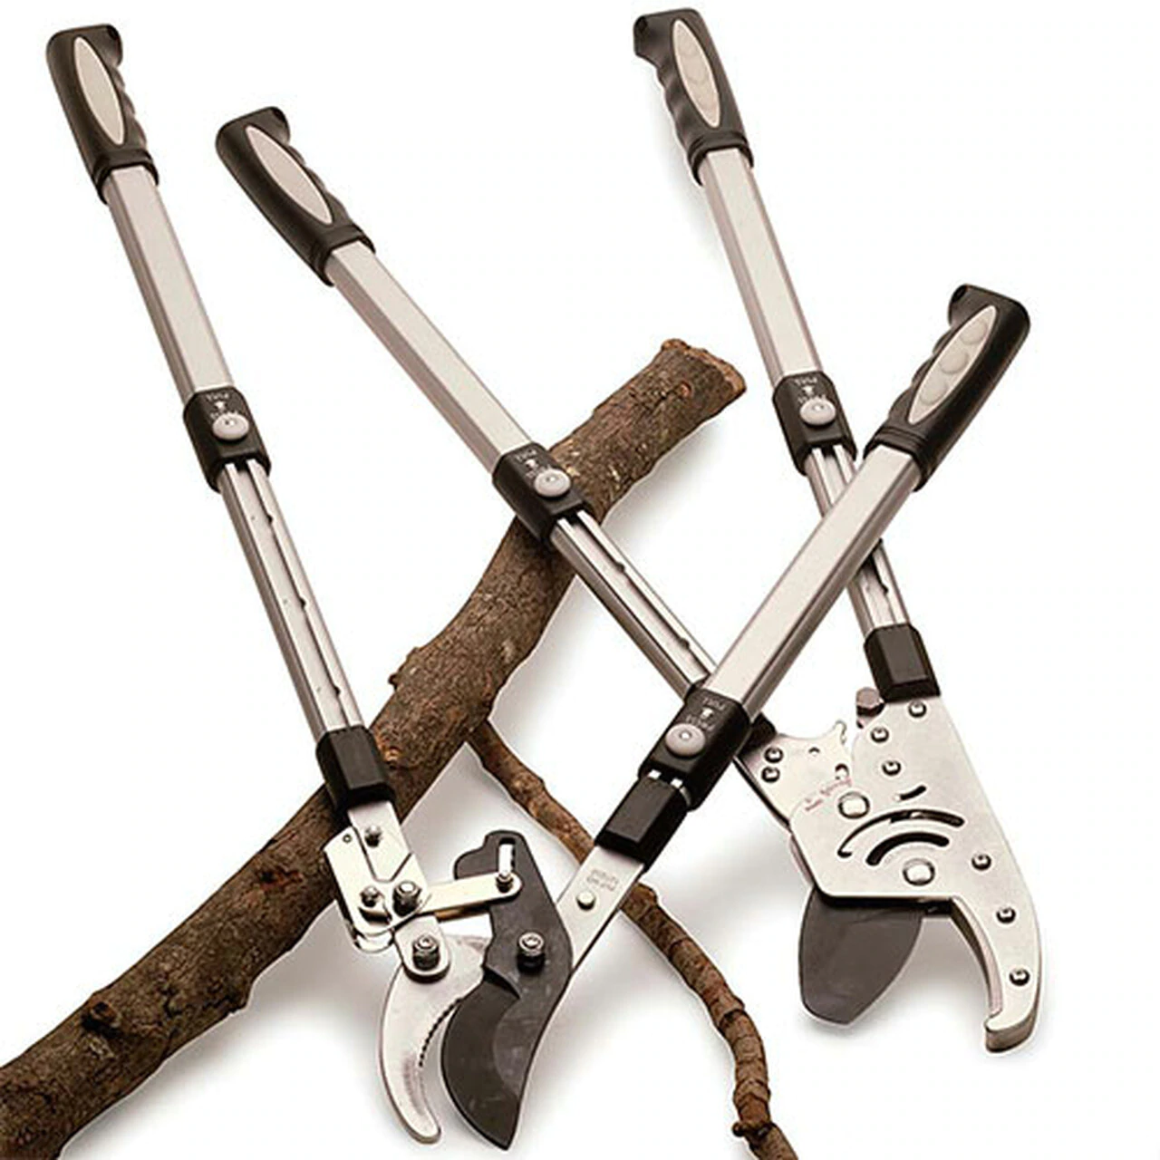
Design Approach
After the drone is a safe distance from the limb, the end effector is ready to cut.
This will be accomplished by a mirror copy of the motor driving the clamp.
This second motor will drive a pair of shears to open when in proximity of the branch and, after a short delay from detachment, cut the branch.
Ratcheting lopper heads that will require less motor.

Slide 12
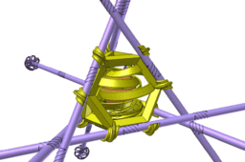
Design Approach
The final consideration for design is the fall contingency.
The end effector must be able to survive multiple falls of up to 50 feet.
This will be accomplished by 3D printing a cage for the end effector that protects the motors, clamp, shears, and battery when falling.
3D printed egg drop challenge that shows how to protect key elements like batteries.

Slide 13
Project Demonstration & Testing
For any demonstrations or testing, safety considerations outlined by FPL in the Scope of Work document will be followed
Drone is tethered to a ground anchor
No flight within 500 feet of live power lines
Flight area clear of traffic
PPE
Compliance with FAA airspace restrictions
Any testing apparatuses will be approved by FPL before use (e.g. stand to mount test branches on)

Slide 14
Project Demonstration & Testing
Any demonstrations to a public audience will be done with ample space
Flight area (~10 ft radius circle)
Spectator area (outside of radius)
Drone flight area will be clearly marked with tape during public demonstrations
Drone tethered to center of marked circular area to prevent flight accidents outside of the area
Anyone inside of flight area will wear PPE as described in the safety guidelines

Slide 15
Project Demonstration & Testing
For either purpose, the drone does not need to fly at an altitude greater than 10 feet
Higher visibility of drone during demonstration
Less damage to drone in the event of an accident
Drone trimming demonstrations/testing will be done on a branch mounted to a secure stand
1/2 inch diameter branch
Purchased from a suitable vegetation retailer

Slide 16
Capstone Design Expo Demonstration
The following will be demonstrated to a public audience:
1. Horizontal (0-30 deg.) branch trimming, assisted by the on-board feed.
2. Vertical (60-90 deg.) branch trimming, assisted by the on-board feed.
3. End effector detachment during cutting and ease-of reattachment afterwards.
4. Drone maneuverability with end effector
Features such as range and end effector drop resistance cannot be demonstrated in an expo setting

Slide 17
Schedule, Tasks, and Milestones
Drone operation and load testing: Jan 31 - Feb 14.
End effector mechanical design: Feb 14 - March 4.
End effector electrical design: Feb 28 - March 18.
Positioning system mechanical design: Feb 14 - Feb 28.
Positioning system electrical design: Feb 21 - March 11.
Software design: Feb 14 - March 18.
Integration: March 18 - April 9.
Battery and drop testing: April 2 - April 9.
Final Demonstration Testing: April 9 - April 27.

Slide 18
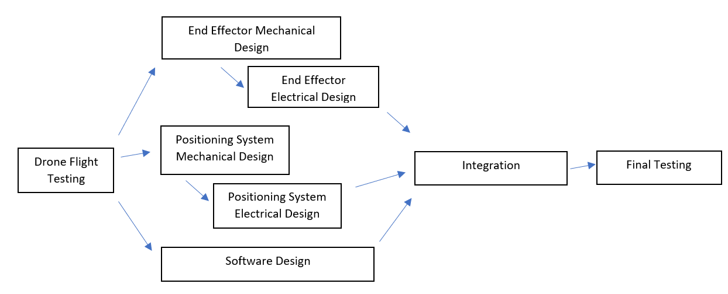
Schedule Flow Chart

Slide 19
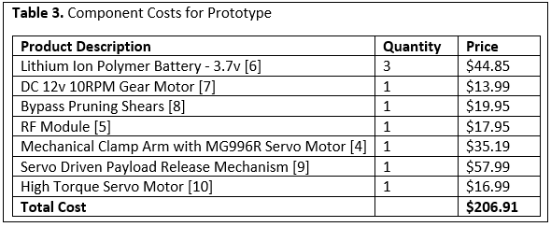
Cost Analysis
Approximate total cost for components (excluding microprocessor) will be $206.91.

Slide 20
Leadership Roles
Nikhil Patel - Software Team Lead, Document Coordinator
Matthew Ramberger - Testing Team Lead
Darrell Fambro - Document Editor, Webmaster
Keith Liang - Hardware Design Team Lead
Tyler Bryant - Director of Communications, Expo Coordinator

